Slide 1
CSE 212
Object Oriented Programming (Java)
IO and String
Lecture 3
Tahsina Hashem
Rafsan Jani

Slide 2
Java User Input
There are several ways to get input from the user in Java. You will learn to get input by using Scanner object in this article.
The Scanner class is used to get user input, and it is found in the java.util package. Use the following code to import Scanner.
import java.util.Scanner;
To use the Scanner class, create an object of the class and use any of the available methods found in the Scanner class documentation.
Scanner input = new Scanner(System.in);

Slide 3
Java User Input
The Java Scanner class breaks the input into tokens using a delimiter which is whitespace by default.
It provides many methods to read and parse various primitive values.
The Java Scanner class is widely used to parse text for strings and primitive types using a regular expression. It is the simplest way to get input in Java.
By the help of Scanner in Java, we can get input from the user in primitive types such as int, long, double, byte, float, short, etc.
The Java Scanner class extends Object class and implements Iterator and Closeable interfaces.

Slide 4
Java User Input: Example
//Reading an integer from the Keyboard:
import java.util.Scanner;
class Input {
public static void main(String[] args) {
Scanner input = new Scanner(System.in);
System.out.print("Enter an integer: ");
int number = input.nextInt();
System.out.println("You entered " + number);
}
}

Slide 5
Java User Input: Example
//Reading strings from the Keyboard:
import java.util.Scanner;
class Input {
public static void main(String[] args) {
Scanner input = new Scanner(System.in);
System.out.print("Enter your name: ");
String name= input.nextLine();
System.out.println("You Name: " + name);
}
}

Slide 6
How to get Java Scanner
To get the instance of Java Scanner which reads input from the user, we need to pass the input stream (System.in) in the constructor of Scanner class. For Example:
Scanner in = new Scanner(System.in);
To get the instance of Java Scanner which parses the strings, we need to pass the strings in the constructor of Scanner class. For Example:
Scanner in = new Scanner("Hello CSE 27");

Slide 7
Scanner Class Constructor
Scanner(File source) | It constructs a new Scanner that produces values scanned from the specified file.
Scanner(File source, String charsetName) | It constructs a new Scanner that produces values scanned from the specified file.
Scanner(InputStream source) | It constructs a new Scanner that produces values scanned from the specified input stream.
Scanner(InputStream source, String charsetName) | It constructs a new Scanner that produces values scanned from the specified input stream.
Scanner(Readable source) | It constructs a new Scanner that produces values scanned from the specified source.

Slide 8
Scanner Class Constructor
Scanner(String source) | It constructs a new Scanner that produces values scanned from the specified string.
Scanner(ReadableByteChannel source) | It constructs a new Scanner that produces values scanned from the specified channel.
Scanner(ReadableByteChannel source, String charsetName) | It constructs a new Scanner that produces values scanned from the specified channel.
Scanner(Path source) | It constructs a new Scanner that produces values scanned from the specified file.
Scanner(Path source, String charsetName) | It constructs a new Scanner that produces values scanned from the specified file.

Slide 9
Check for Next Token
boolean | hasNext() | It returns true if this scanner has another token in its input.
boolean | hasNextBigDecimal() | It is used to check if the next token in this scanner's input can be interpreted as a BigDecimal using the nextBigDecimal() method or not.
boolean | hasNextBigInteger() | It is used to check if the next token in this scanner's input can be interpreted as a BigDecimal using the nextBigDecimal() method or not.
boolean | hasNextBoolean() | It is used to check if the next token in this scanner's input can be interpreted as a Boolean using the nextBoolean() method or not.
boolean | hasNextByte() | It is used to check if the next token in this scanner's input can be interpreted as a Byte using the nextBigDecimal() method or not.
boolean | hasNextDouble() | It is used to check if the next token in this scanner's input can be interpreted as a BigDecimal using the nextByte() method or not.

Slide 10
Check for Next Token
boolean | hasNextFloat() | It is used to check if the next token in this scanner's input can be interpreted as a Float using the nextFloat() method or not.
boolean | hasNextInt() | It is used to check if the next token in this scanner's input can be interpreted as an int using the nextInt() method or not.
boolean | hasNextLine() | It is used to check if there is another line in the input of this scanner or not.
boolean | hasNextLong() | It is used to check if the next token in this scanner's input can be interpreted as a Long using the nextLong() method or not.
boolean | hasNextShort() | It is used to check if the next token in this scanner's input can be interpreted as a Short using the nextShort() method or not.

Slide 11
Input Types
Method | Description
nextBoolean() | Reads a boolean value from the user
nextByte() | Reads a byte value from the user
nextDouble() | Reads a double value from the user
nextFloat() | Reads a float value from the user
nextInt() | Reads a int value from the user
next() | Reads a String till delimiter from the user
nextLine() | Reads a String till new line from the user
nextLong() | Reads a long value from the user
nextShort() | Reads a short value from the user

Slide 12
Java User Input: Example
import java.util.Scanner;
class MyClass {
public static void main(String[] args) {
Scanner myObj = new Scanner(System.in);
System.out.println("Enter name, age and salary");
// String input
String name = myObj.nextLine();
// Numerical input
int age = myObj.nextInt();
double salary = myObj.nextDouble();
// Output input by user
System.out.println("Name: " + name);
System.out.println("Age: " + age);
System.out.println("Salary: " + salary);
}
}

Slide 13
Java User Input: Example
import java.util.*;
public class ScannerClassExample2 {
public static void main(String args[]){
String str = "Hello/This is JavaClass/For CSE-27.";
//Create scanner with the specified String Object
Scanner scanner = new Scanner(str);
System.out.println("Boolean Result: "+scanner.hasNextBoolean());
//Change the delimiter of this scanner
scanner.useDelimiter("/");
//Printing the tokenized Strings
System.out.println("---Tokenizes String---");
while(scanner.hasNext()){
System.out.println(scanner.next());
}
//Display the new delimiter
System.out.println("Delimiter used: " +scanner.delimiter());
scanner.close();
}
}

Slide 14
Java String
Generally, String is a sequence of characters. But in Java, string is an object that represents a sequence of characters.
The java.lang.String class is used to create a string object.
There are two ways to create String object:
By string literal
By new keyword

Slide 15
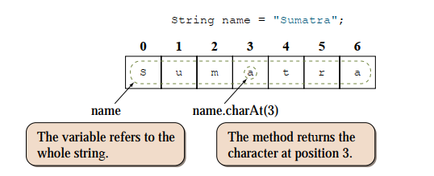
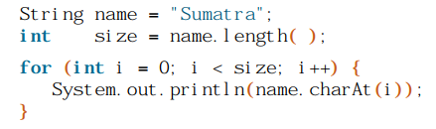
Java String
We access individual characters of a string by calling the charAt method of the String object.
For example, to display the individual characters of the string “Sumatra” one at a time, we can write

Slide 16
String Constructor
String class provide many constructors and more than 40 methods for examining in individual characters in a sequence
You can create a String from a String value or from an array of characters. – String newString = new String(stringValue);
The argument stringValue is a sequence of characters enclosed inside double quotes – String message = new String (“Welcome”); – String message = “Welcome”;

Slide 17
String Literal
Java String literal is created by using double quotes. For Example:
String s="welcome";
Each time you create a string literal, the JVM checks the "string constant pool" first. If the string already exists in the pool, a reference to the pooled instance is returned. If the string doesn't exist in the pool, a new string instance is created and placed in the pool. For example:
String s1="Welcome";
String s2="Welcome";//It doesn't create a new instance

Slide 18
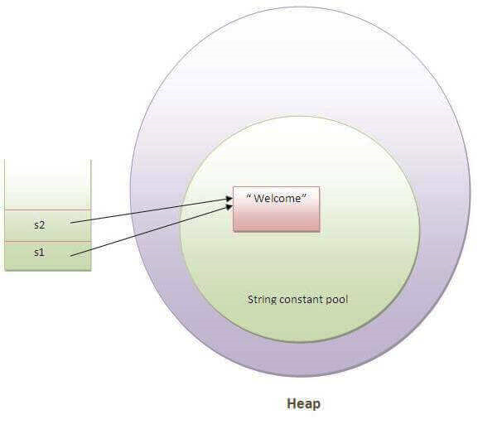
String Literal
Notes:
A string constant pool is a separate place in the heap memory where the values of all the strings which are defined in the program are stored. When we declare a string, an object of type String is created in the stack, while an instance with the value of the string is created in the heap. On standard assignment of a value to a string variable, the variable is allocated stack, while the value is stored in the heap in the string constant pool.
https://www.geeksforgeeks.org/string-constant-pool-in-java/
https://www.geeksforgeeks.org/stack-vs-heap-memory-allocation/

Slide 19
String Literal
In the above example, only one instance with the value of the string will be created.
Firstly, JVM will not find any string instance with the value "Welcome" in string constant pool, that is why it will create a new instance.
After that it will find the string with the value "Welcome" in the pool, it will not create a new instance but will return the reference to the same instance.
To make Java more memory efficient (because no new instance is created if it exists already in the string constant pool).

Slide 20
String Literal
The string constant pool is a small cache that resides within the heap. Java stores all the values inside the string constant pool on direct allocation. This way, if a similar value needs to be accessed again, a new string object created in the stack can reference it directly with the help of a pointer.
In other words, the string constant pool exists mainly to reduce memory usage and improve the re-use of existing instances in memory. When a string object is assigned a different value, the new value will be registered in the string constant pool as a separate instance.

Slide 21
By new keyword
One way to skip this memory allocation is to use the new keyword while creating a new string object.
The ‘new’ keyword forces a new instance to always be created regardless of whether the same value was used previously or not.
Using ‘new’ forces the instance to be created in the heap outside the string constant pool which is clear, since caching and re-using of instances isn’t allowed here.
String s=new String("Welcome");
In such case, JVM will create a new string instance in normal (non-pool) heap memory
The variable s will refer to the instance in a heap (non-pool).

Slide 22
String Literal vs. String Object
If two string literals have the same contents, they will share the same storage inside the common pool.
On the other hand, String objects created via the new operator and constructor are kept in the heap. Each String object in the heap has its own storage just like any other object.
There is no sharing of storage in heap even if two String objects have the same contents.

Slide 23
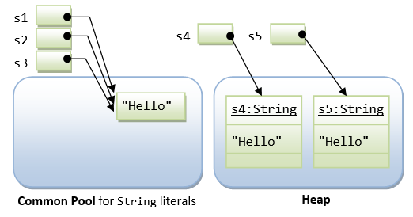
String Literal vs. String Object
String s1 = "Hello"; // String literal
String s2 = "Hello"; // String literal
String s3 = s1; // same reference
String s4 = new String("Hello"); // String object
String s5 = new String("Hello"); // String object

Slide 24
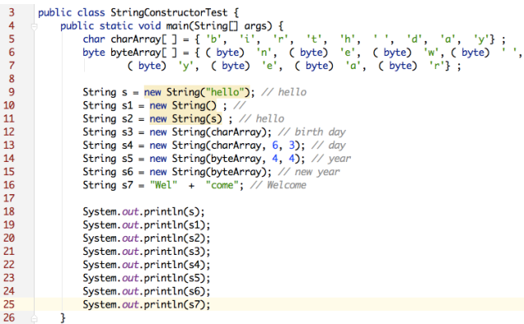
Example: String Constructor

Slide 25
String: Example
Method | Description
char charAt(int index) | returns char value for the particular index
int length() | returns string length
static String format(String format, Object... args) | returns a formatted string.
static String format(Locale l, String format, Object... args) | returns formatted string with given locale.
String substring(int beginIndex) | returns substring for given begin index.
String substring(int beginIndex, int endIndex) | returns substring for given begin index and end index.
boolean contains(CharSequence s) | returns true or false after matching the sequence of char value.

Slide 26
String: Example
static String join(CharSequence delimiter, CharSequence... elements) | returns a joined string.
static String join(CharSequence delimiter, Iterable<? extends CharSequence> elements) | returns a joined string.
boolean equals(Object another) | checks the equality of string with the given object.
boolean isEmpty() | checks if string is empty.
String concat(String str) | concatenates the specified string.
String replace(char old, char new) | replaces all occurrences of the specified char value.
String replace(CharSequence old, CharSequence new) | replaces all occurrences of the specified CharSequence.

Slide 27
String: Example
static String equalsIgnoreCase(String another) | compares another string. It doesn't check case.
String[] split(String regex) | returns a split string matching regex.
String[] split(String regex, int limit) | returns a split string matching regex and limit.
String intern() | returns an interned string.
int indexOf(int ch) | returns the specified char value index.
int indexOf(int ch, int fromIndex) | returns the specified char value index starting with given index.
int indexOf(String substring) | returns the specified substring index.
int indexOf(String substring, int fromIndex) | returns the specified substring index starting with given index.

Slide 28
String: Example
String toLowerCase() | returns a string in lowercase.
String toLowerCase(Locale l) | returns a string in lowercase using specified locale.
String toUpperCase() | returns a string in uppercase.
String toUpperCase(Locale l) | returns a string in uppercase using specified locale.
String trim() | removes beginning and ending spaces of this string.
static String valueOf(int value) | converts given type into string. It is an overloaded method.

Slide 29
Immutable String in Java
In java, string objects are immutable. Immutable simply means unmodifiable or unchangeable.
Once string object is created its data or state can't be changed but a new string object is created.
Let's try to understand the immutability concept by the example given below:
class Testimmutablestring{
public static void main(String args[]){
String s=“Sachin";
String snew = s.concat(“ Tendulkar"); //concat() method appends the string at the end and save it to snew
System.out.println(s);//s is not changed!!
//will print Sachin because strings are immutable objects
}
}

Slide 30
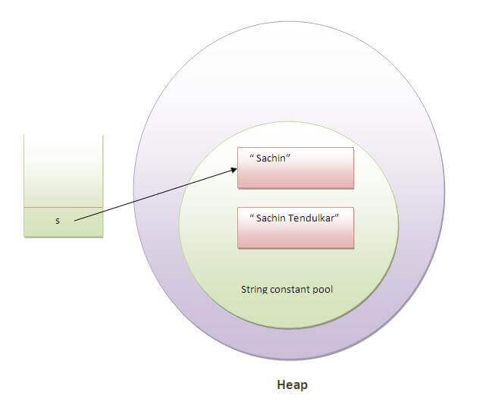
Immutable String in Java

Slide 31
Why string objects are immutable in java?
Because java uses the concept of string literal.
Suppose there are 5 reference variables, all refers to one object "sachin". If one reference variable changes the value of the object, it will be affected to all the reference variables. That is why string objects are immutable in java.

Slide 32
Extracting Substrings
substring method enable a new String object to be created by copying part of an existing String object – substring (int startIndex) ‐ copies the characters form the starting index to the end of the String – substring(int beginIndex, int endIndex) ‐ copies the characters from the starting index to one beyond the endIndex
Example:
public class SubstringExample{
public static void main(String args[]){
String s1="javatpoint";
System.out.println(s1.substring(2,4));//returns va
System.out.println(s1.substring(2));//returns vatpoint
}}

Slide 33
Extracting Substrings
The following program uses substring( ) to replace all instances of one substring with another within a string:
// Substring replacement. class StringReplace { public static void main(String args[]) { String org = "This is a test. This is, too."; String search = "is"; String sub = "was"; String result = ""; int i; do { // replace all matching substrings System.out.println(org); i = org.indexOf(search); if(i != -1) { result = org.substring(0, i); result = result + sub;
result = result + org.substring(i + search.length()); org = result; }} while(i != -1);}}
OUTPUT:
This is a test. This is, too. Thwas is a test. This is, too. Thwas was a test. This is, too. Thwas was a test. Thwas is, too. Thwas was a test. Thwas was, too.

Slide 34
String Comparisons
regionMatches compares portions of two String objects for equality – s1.regionMatches (0, s2, 0, 5) – s1.regionMatches (true, 0, s2, 0, 5)
If the first argument is true, the method ignores the case of the characters being compared
startsWith and endsWith check whether a String starts or ends with a specified String – s1.startsWith (s2) – s1.endsWith (s2)
"Foobar".endsWith("bar") and "Foobar".startsWith("Foo") returns true

Slide 35
String Concatenation
Java provide the concat method to concatenate two strings. String s1 = new String (“Happy ”); String s2 = new String (“Birthday”); String s3 = s1.concat(s2);
s3 will be “Happy Birthday”

Slide 36
String Concatenation with Other Data Types
int age = 9; String s = "He is " + age + " years old."; System.out.println(s);
Output: s will be “He is 9 years old.”
The int value in age is automatically converted into its string representation within a String object. This string is then concatenated as before.
The compiler will convert an operand to its string equivalent whenever the other operand of the + is an instance of String.

Slide 37
String Concatenation with Other Data Types
Be careful when you mix other types of operations with string concatenation expressions:
String s = "four: " + 2 + 2; System.out.println(s);
This fragment displays: four: 22

Slide 38
String Search and Split
String Search • Find the position of character/String within a String – int indexOf(char ch) – int lastIndexOf(char ch)
String Split • split() method splits a String against given regular expression and returns a character array • String test = "abc,def,123"; String[] out = test.split(",");
out[0] - abc, out[1] - def, out[2] - 123

Slide 39
Java String compare
We can compare string in java on the basis of content and reference.
It is used in authentication (by equals() method), sorting (by compareTo() method), reference matching (by == operator) etc.
There are three ways to compare string in java:
By equals() method
By == operator
By compareTo() method

Slide 40
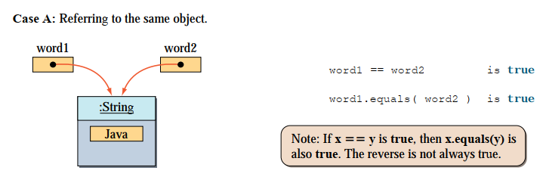
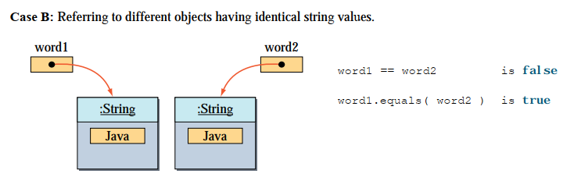
Difference between the equality test and the equals method

Slide 41
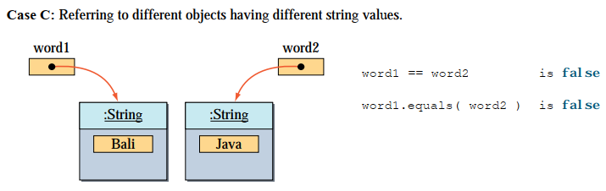
Difference between the equality test and the equals method

Slide 42
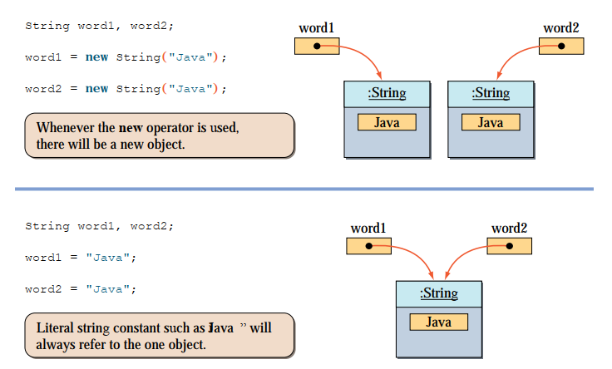
Difference between using and not using the new operator for String

Slide 43
String compare by equals() method
The String equals() method compares the original content of the string. It compares values of string for equality. String class provides two methods:
public boolean equals(Object another) compares this string to the specified object.
public boolean equalsIgnoreCase (String another)
compares this String to another string, ignoring case.

Slide 44
String compare by equals() method
class Teststringcomparison1{
public static void main(String args[]){
String s1="Sachin";
String s2="Sachin";
String s3=new String("Sachin");
String s4="Saurav";
System.out.println(s1.equals(s2));//true
System.out.println(s1.equals(s3));//true
System.out.println(s1.equals(s4));//false
} }

Slide 45
String compare by equals() method
class Teststringcomparison2{
public static void main(String args[]){
String s1="Sachin";
String s2="SACHIN";
System.out.println(s1.equals(s2));//false
System.out.println(s1.equalsIgnoreCase(s2));//true
}
}

Slide 46
String compare by == operator
The = = operator compares references not values.
class Teststringcomparison3{
public static void main(String args[]){
String s1="Sachin";
String s2="Sachin";
String s3=new String("Sachin");
System.out.println(s1==s2);//true (because both refer to same instance)
System.out.println(s1==s3);//false(because s3 refers to instance created in nonpool)
}
}

Slide 47
String compare by compareTo() method
The String compareTo() method compares values lexicographically and returns an integer value that describes if first string is less than, equal to or greater than second string.
Suppose s1 and s2 are two string variables. If:
s1 == s2 :0
s1 > s2 :positive value
s1 < s2 :negative value

Slide 48
String compare by compareTo() method
class Teststringcomparison4{
public static void main(String args[]){
String s1=“Sakib";
String s2=“Sakib";
String s3=“Razzak";
System.out.println(s1.compareTo(s2));//0
System.out.println(s1.compareTo(s3));//1(because s1>s3)
System.out.println(s3.compareTo(s1));//-1(because s3 < s1 )
}
}

Slide 49
String Conversions
Generally, the contents of a String cannot be changed once the string is created, Java provides conversion methods
toUpperCase() and toLowerCase() – Converts all the characters in the string to lowercase or uppercase
class ChangeCase { public static void main(String args[]) { String s = "This is a test."; System.out.println("Original: " + s); String upper = s.toUpperCase(); String lower = s.toLowerCase();
System.out.println("Uppercase: " + upper); System.out.println("Lowercase: " + lower); } }

Slide 50
String Conversions
Generally, the contents of a String cannot be changed once the string is created, Java provides conversion methods
trim() – Eliminates blank characters from both ends of the string
String s = “ Hello ".trim();
puts the string "Hello" into s.
replace(oldChar, newChar) – Replaces a character in the string with a new character
String s = "Hello".replace('l', 'w'); puts the string "Hewwo" into s.

Slide 51
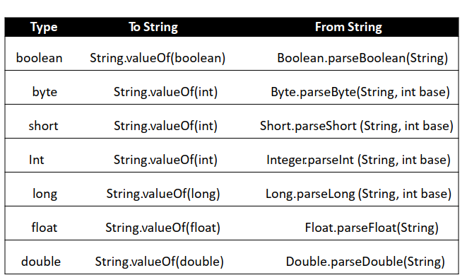
String to Other Conversions
String to Other Conversions • The String class provides valueOf methods for converting a character, an array of characters and numeric values to strings – valueOf method take different argument types

Slide 52
String Conversion Example
To convert an int to a String (3 different ways): int n = 123; String s1 = Integer.toString(n); String s2 = String.valueOf(n); String s3 = n + "";
To convert a string to an int: String s = “1234”; int n = Integer.parseInt(s);

Slide 53
String Related Classes
Java provides three String related classes
java.lang package – String class: Storing and processing Strings but Strings created using the String class cannot be modified (immutable)
– StringBuffer class: Create flexible Strings that can be modified
java.util package – StringTokenizer class: Can be used to extract tokens from a String

Slide 54
StringBuffer
Can be used wherever a string is used – More flexible than String – Can add, insert, or append new contents into a string buffer
The StringBuffer class has three constructors and more than 30 methods for managing the buffer and for modifying strings in the buffer
Every StringBuffer is capable of storing a number of characters specified by its capacity
StringBuffer may have characters and substrings inserted in the middle or appended to the end.
It will automatically grow to make room for such additions and often has more characters pre-allocated than are actually needed, to allow room for growth.

Slide 55
String vs. StringBuffer
A String object is immutable, which means that once a String object is created, we cannot change it.
In other words, we can read individual characters in a string, but we cannot add, delete, or modify characters of a String object.
Remember that the methods of the String class, such as replaceAll() and substring(), do not modify the original string; they return a new string.
Java adopts this immutability restriction to implement an efficient memory allocation scheme for managing String objects.
The immutability is the reason why we can treat the string data much as a primitive data type.

Slide 56
StringBuffer Constructors
public StringBuffer( )
No characters in it and an initial capacity of 16 characters
public StringBuffer (int length)
No characters in it and an initial capacity specified by the length argument
public StringBuffer (String string)
Contains String argument and an initial capacity of the buffer is 16 plus the length of the argument

Slide 57
StringBuffer Methods
capacity method:
int capacity( )
Returns the current capacity of the string buffer
length method:
int length( )
Returns the number of characters in the string buffer
// StringBuffer length vs. capacity. class StringBufferDemo { public static void main(String args[]) { StringBuffer sb = new StringBuffer("Hello"); System.out.println("buffer = " + sb); System.out.println("length = " + sb.length()); System.out.println("capacity = " + sb.capacity()); }
}
OUTPUT:
buffer = Hello length = 5 capacity = 21

Slide 58
StringBuffer Methods
setLength method:
void setLength(int len)
Sets the length of the string buffer
If the newLength argument is less than the current length of the string buffer, then the string buffer is truncated to contain exactly the number of characters given by the newLength argument
charAt method:
char charAt(int where)
Returns the character at a specific index in the string buffer
The first character of a string buffer is at index 0

Slide 59
StringBuffer Methods
You can append new contents at the end of a string buffer
insert new contents at a specified position in a string buffer
delete of replace characters in a string buffer
Provides overload methods to append and insert boolean, char, char array, double, float, int, long and String into string buffer

Slide 60
StringTokenizer Class
Break a string into pieces (tokens) so that information contained in it can be retrieved and processed
Specify a set of characters as delimiters when constructing a StringTokenizer object
StringTokenizer class is available since JDK 1.0 and the String.split() is available since JDK 1.4
StringTokenizer is a legacy class, retained for compatibility reasons, the use is discouraged!

Slide 61
StringTokenizer Class
Constructors – StringTokenizer(String str, String delim) – StringTokenizer(String str)
Methods – hasMoreToken()
‐ Returns true if there is a token left in the string – nextToken()
‐ Returns the next token in the string – nextToken(String delim)
‐ Returns the next token in the string after resetting the delimiter to delim – countToken( )
‐ Returns the number of tokens remaining in the string tokenizer

Slide 62
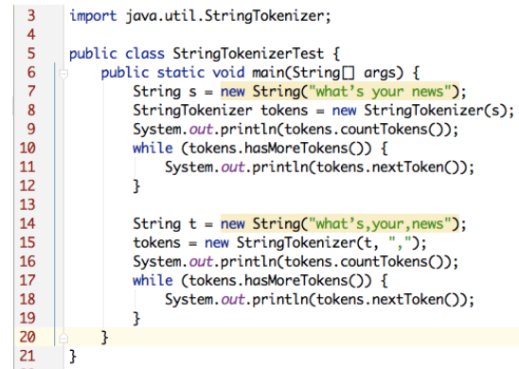
StringTokenizer Class

Slide 63
Try By Yourself
Show examples of the following methods of the String class. Try to cover as several possible usages/example for each of these methods.
compareTo
compareToIgnoreCase
startsWith
endsWith
equals
equalsIgnoreCase
indexOf
lastIndexOf
length
replace(char oldChar, char newChar)
substring
toCharArray
toLowerCase
toUpperCase
trim
valueOf

Slide 64
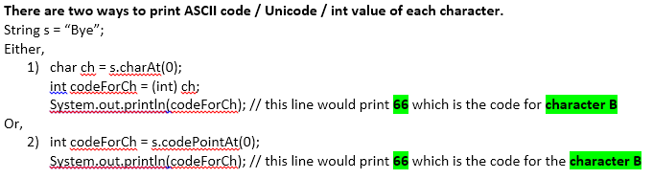
Try By Yourself
Write a Java method to count the number of vowels, consonants and digits in a string?
Input a word into a String. Print each character and it’s ascii value on a line by itself.
Hint:
Given a string and a substring, the task is to replace all occurrences of the substring with space.

Slide 65
Try By Yourself
Write a java program to compare two strings lexicographically.
Write a Java program to concatenate a given string to the end of another string.
Write a Java program to check whether two String objects contain the same data.
Write a Java program to trim any leading or trailing whitespace from a given string
Write a Java program to get a substring of a given string between two specified positions.
Write a Java program to determine whether or not the input sting is a Palindrome?
Write a Java program to find the second most frequent character in a given string.
Write a Java program to print after removing duplicate characters from a given string.

Slide 66
Try By Yourself
Write a Java program to concatenate a given string with itself of a given number of times.
Write a Java program to count the occurrences of a given string in another given string.
Write a program to reverse String in Java i) without using the StringBuffer class and ii) using StringBuffer class
Write a Java program to reverse words in a sentence.
Write a Java program to Convert Character Array To String.
Write a Java program to count a number of words in a given String.
[The words are separated by the following characters: space (‘ ‘) or newline (‘\n’) or tab (‘\t’) or a combination of these. For example, if input "Java is great" your program should print 3.]
If the two strings contain all the same letters in the same frequencies, then they are called "Anagrams". Write a Java program to determine whether the two input strings are “Anagrams” or “Not Anagrams”

Slide 67
Try By Yourself
Write a Java program to add two matrices of the same size
Write a Java program to find the common elements between two arrays.
String s="23.5 3 8 20 32";
Write a program that adds the above numbers and prints sum.
Write a Java program that takes a string as input and removes multiple consecutive whitespaces from the string (You can use the String class in java) and show the output.
INPUT: This is a test.
OUTPUT: This is a test.

Slide 68
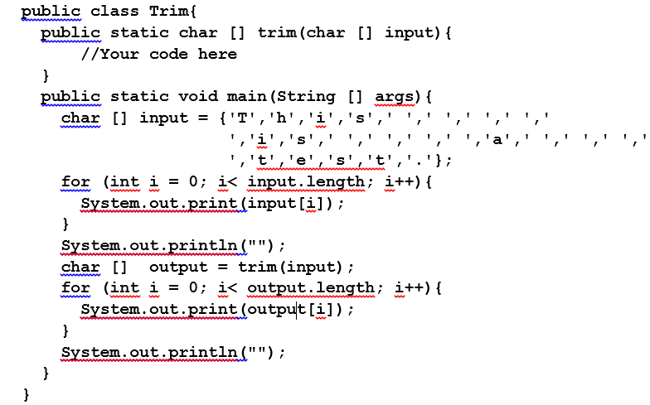
Try By Yourself
Write a function trim() that will take an array of characters as an input and remove multiple consecutive spaces from the array (You cannot use the String class in java). Following example code generates the output below:

Slide 69
Reading Materials
Java The Complete Reference
Author : Herbert Schildt
Chapter 16 of your text book
Web Source:
http://docs.oracle.com/javase/tutorial/
http://www.tutorialspoint.com/java/
http://www.javatpoint.com/java-tutorial/
https://www.geeksforgeeks.org/java/

Slide 70
Today’s experiments - 1

Slide 71
Today’s experiments - 2

Slide 72
Today’s experiments - 3

Slide 73
Today’s experiments - 4

